Slide 1


Slide 2

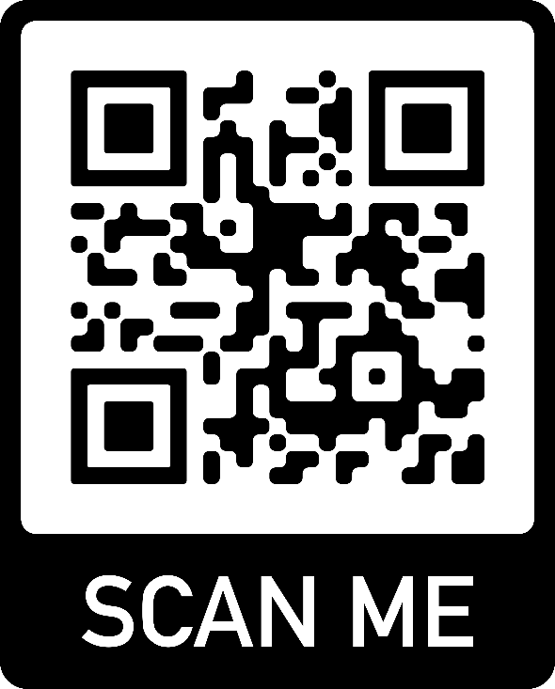

Slide 3


“GreenFork” Project Foundation

Slide 4

“Project Idea”
Concept: A healthy, organic food brand App in Egypt.
Focus: Delivering 100% organic and healthy meals nationwide.
Specialty: Providing specialized packages for people with Diabetes.

Slide 5

GreenFork: Main Business Goal
Goal: To establish GreenFork as the leading, trusted brand for specialized, recurring healthy meal subscriptions in the Greater Cairo Area.
Metric: Achieve 10,000 active monthly users and
secure 3-5 major corporate B2B partners within 3 Years.
Focus: Drive profitability by maximizing the Customer Lifetime Value through the subscription model.

Slide 6


“Services Offered”
Healthy Meal Delivery: Preprepared, organic meals for a convenient, healthy lifestyle.
Diabetic Friendly Packages: Specialized meal plans designed with balanced nutrition to support diabetic patients.
“Health and Wellness Overall”

Slide 7
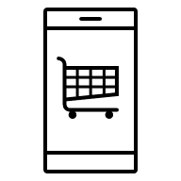
“Unique Selling Points (USP)”
▶ Easy to Use App: Our mobile app makes ordering, tracking, and
managing your subscription effortless.
▶ Specialized Diabetic Packages: We cater to a specific health need with
tailored meal plans.

Slide 8
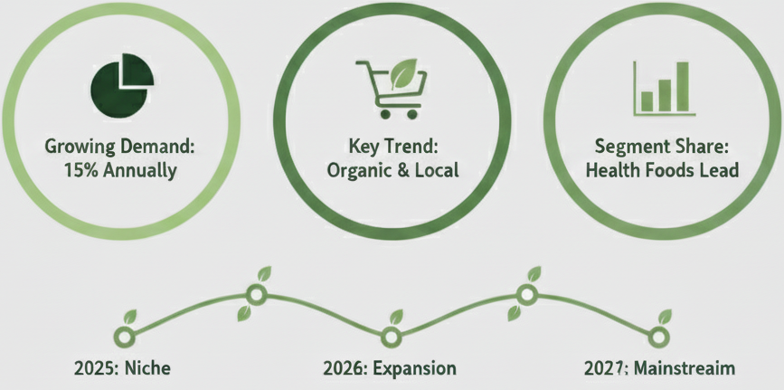
“Initial Marketing Overview”

Slide 9

“Short Marketing Goal”
Awareness/Acquisition: Gain a minimum of 2,000 new, relevant followers combined across Social Media.
Engagement: Achieve an average engagement rate of at least 6% on organic content.
Leads (Qualified Prospects): Generate a minimum of 60 qualified customer inquiries directly via social media over (6 months).
Sales (Conversion): Convert a minimum of 20% of those qualified leads into paying customers.

Slide 10

“Marketing Channels”
Influencer Marketing: Dr. Norhan Kandeel, Dr. Shrouk Ali – Health Podcasts
Social Media Marketing: to share engaging content like meal photos, healthy tips, and customer testimonials to build a community.
Content Marketing: Create research-based posts and AI-generated videos to educate the audience about health and nutrition in a creative and informative way.
Search & Ads: Increase online visibility with Google Ads and SMO, while using paid Meta campaigns to target and reach new customers effectively.
Direct Marketing: Send weekly meal plans, special offers, and updates directly to customers via email for a personalized experience.
Offline Presence: Build direct connections by participating in health fairs (Egy Health Exp(Doctors or nutritionists Recommendation) - Cairo Food Week (visually appealing tasting samples of your meals) - Sara's Organic Food Experiences (code) How? Scan the QR code for 50 EGP on your first order!
Mobile Marketing: Strengthen customer loyalty with a simple app for easy customization of meal plans, nutrition tracking, and exclusive offers.

Slide 11

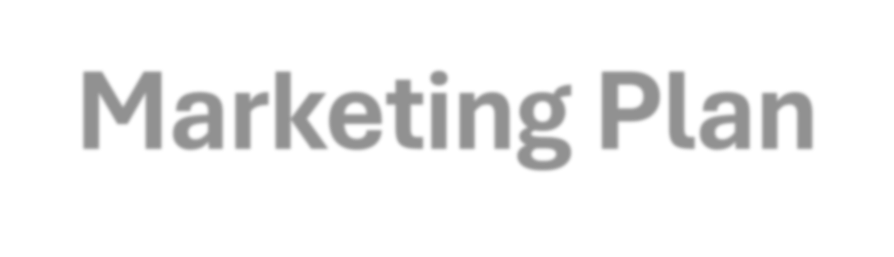
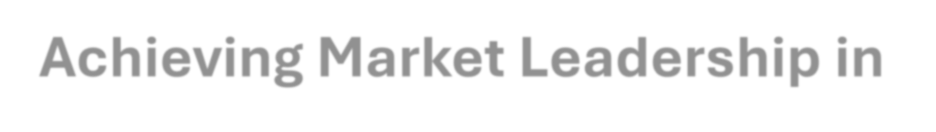
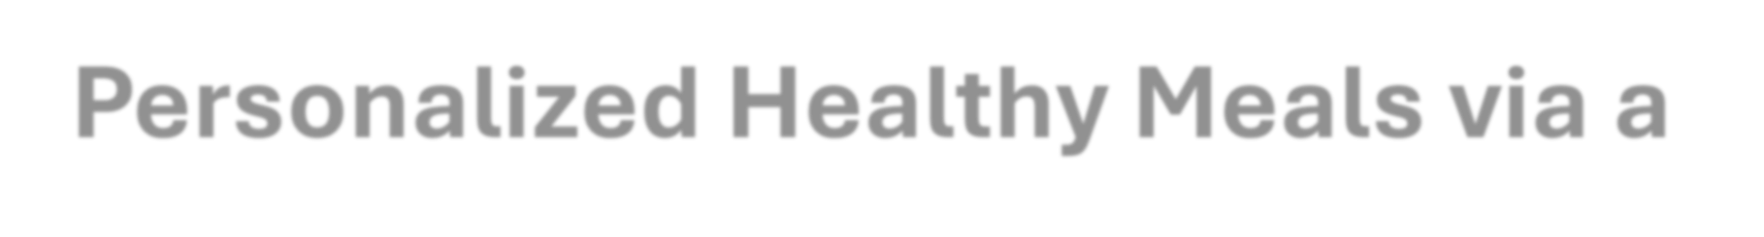
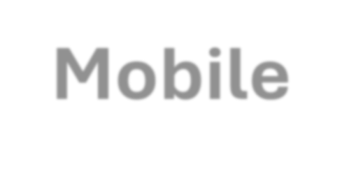


“GreenFork”Digital
Marketing Plan
Achieving Market Leadership in Personalized Healthy Meals via a Mobile-First Approach

Slide 12
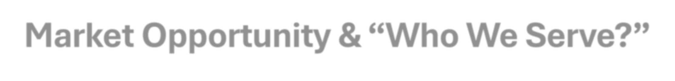
Market Opportunity s “Who We Serve?”
Opportunity: High demand for personalized diets and wellness solutions among the urban middle class in Greater Cairo/Alexandria.
Target: The Corporate High Performer(Age 25-65)
Profile: Middle/High income, health-conscious,
Tech Savy
values time saving and reliability.

Slide 13
“SWOT Analysis”
Strengths (S) | Weaknesses (W) | Opportunities (O) | Threats (T)
Quality Control: Owns kitchen; accurate, guaranteed nutrition. | Zero Awareness: Needs major initial marketing spend. | Health Trends: Exploit high demand for specialized diets. | Price Wars: Aggregators can easily undercut premium cost.
Packages: Customized package with subscription for every segment. | High Cost: Expensive sourcing and complex logistics in Egypt. | B2B: Untapped Employee and Student meal plans. | Inflation: Rising food cost reduces consumer premium spending.
Tech: Seamless app UX for personalization. | Limited Menu: Specialization restricts mass market size. | Digital Ready: High mobile/digital payment acceptance supports app growth. | Wi-fi: no Wi-fi means no GreenFork Ramses Central

Slide 14


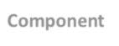
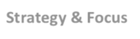
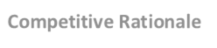
“Marketing Mix”
P | Component | Strategy & Focus | Competitive Rationale
Product | Healthy Food- Diabetic Friendly Meals- Diet Meals- High Protein items- Healthy Juices | Offers personalized, certified diets (Keto, Calorie Control, Sugar-Free) via a smart app. | Sells specific Nutrition item details for every Segment.
Price | Premium & Value-Based Pricing | Price reflects superior quality, customization, and reliability. Avoids price wars with bulk/discount competitors. | Justified by Expertise & Convenience
Place | Direct-to-Consumer App & Focused Logistics | All orders through GreenFork App. Cloud Kitchen strategically located near high-income Cairo suburbs. | Full Control over data and quality; maximizes logistical efficiency and AOV.
Promotion | Authority & Trial Marketing | Use Dietitian/Micro- Influencer partnerships | Builds Trust and Credibility (SPEAK objective) and converts leads with low-risk testing.

Slide 15

“Date & Fig Energy Elixir” Nutritions
Estimated Nutrition (Per Serving) | Value | Notes
Calories | 400 – 480 kcal | (Best for General People – Employees- Students)
Protein | 30 – 38 g | High protein.
Carbohydrates | 45 – 55 g | Primarily complex carbs.
Dietary Fiber | 8 – 12 g | Excellent source of fiber for digestive health and satiety.
Total Fat | 12 – 18 g | Mostly unsaturated fats from olive oil and quinoa.
Vitamins/Minerals | High in Vitamin C, K, Iron, and Magnesium. | Nutrient-dense meal.

Slide 16

“Competitor 1:Talabat”
Component | Strategy Summary | GreenFork Impact
Business Model | Aggregator Leader: Integrates healthy options (restaurants and tMart groceries) seamlessly using filters and tags to offer maximum variety and convenience. | Benchmark Set: Talabat sets the standard for delivery speed and variety. GreenFork cannot compete on scale or price.
Core Focus | Accessibility & Affordability: Leverages scale and promotions to make healthy eating easy and affordable. Focuses on informed choices and transactional volume. | Niche Focus Required: GreenFork must shift away from the viral/discount culture and focus on premium quality, niche specialization, and education to build deep trust and loyalty.
SWOT Summary | Strength: Unmatched reach and delivery network. Weakness: Customer loyalty is still heavily driven by price/discounts. | Threat: Talabat can easily scale up investment in the "healthy" niche, use exclusivity deals, or undercut pricing to squeeze out competitors.

Slide 17
“Social Media Analysis”
 | Component | Facebook (Talabat Egypt)
1 | Channel | Facebook is critical in Egypt, capturing 79.36% of the social media market share.
2 | Link of channel | https://www.facebook.com/TalabatEG
3 | Followers | 2.8M
5 | Reviews | Not always positive
6 | Rating | Medium (2.5 - 4)
7 | About | 1# Food Delivery App in Egypt
8 | Posting Regular or not | Always on campaigns
9 | # of posts/week | 3 - 7 weekly
10 | average likes / post | 150-500
11 | average Comments / post | Low (50 – 500)
12 | Engagement Rate | 6.6
13 | paid posts/not | Paid adv
14 | Type of content | Value-driven campaigns, Community initiatives
15 | Tone of voice | Creative and meaningful tone.
16 | Call-to-Action | Transactional (Order Now)
17 | Comments Replies | Yes
18 | Designs? | High quality, uniform visual aspects.
19 | Keep Identity | Yes
20 | Stories content | Yes
21 | Where in buyer journey | Conversion, Loyalty
22 | Language | Local Arabic Egyptian Language
 | Component | Detail (Focus on Egypt)
1 | Channel | Instagram captures a smaller but highly visual and engaged segment of the Egyptian social media market.
2 | Link of channel | https://www.instagram.com/talabat_egypt/
3 | Followers | 357K
4 | Following | 13
5 | Reviews | Used to gather customer feedback for product enhancement and visual representation.
6 | Rating | Bad.
7 | About | 1# Food Delivery App in Egypt
8 | Posting Regular or not | Regular and High Volume
9 | # of posts/week | 3 – 7 Weekly
10 | average likes / post | Moderate (50 – 500)
11 | average Comments / post | Low (10- 100)
12 | Engagement Rate | Low/Moderate
13 | paid posts/not | Extensive paid campaigns; influencer collaborations.
14 | Type of content | Visually appealing offers, Video reviews.
15 | Tone of voice | Personable
16 | Call-to-Action | Transactional
17 | Comments Replies | Yes
18 | Designs? | High quality, high-resolution images
19 | Keep Identity | Yes
20 | Stories content | Yes
21 | Where in buyer journey | Conversion, Loyalty
22 | Language | Local Arabic Egyptian Language

Slide 18
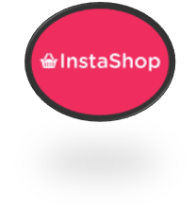
“Competitor 2: InstaShop”
Component | Summary | GreenFork Impact
Strategy | Ingredient Speed: Connects users to specialty health/organic stores for{30-60} minute grocery delivery. Sells convenience for home cooking. | Direct Threat to Meal Prep: InstaShop captures the ingredient market. GreenFork must offer the finished, specialized, portion-controlled meal.
Weakness | Systemic issues with inventory accuracy (substitutions) and inconsistent delivery time/freshness for premium produce. | GreenFork Opportunity: GreenFork must guarantee superior quality control and delivery reliability to justify its premium price.
Threat | As part of the Talabat/Delivery Hero group, they represent an integrated logistics network that can aggressively bundle prepared food and grocery. | Focus on Niche: GreenFork must deepen its niche specialization and trust to avoid being commoditized by the larger ecosystem.

Slide 19
“Social Media Analysis”
 | Component | Detail
1 | Channel | Facebook
2 | Link of channel | https://www.facebook.com/instashopEgypt
3 | Followers | 155K
4 | Reviews | Not Good
5 | Rating | (2.5 – 3.5)
6 | About | Focuses on its wide range of services: "All You Need, In One Reliable App"—Supermarkets, Pharmacies, Pet Shops.
7 | Posting Regular or not | Low
8 | # of posts/week | 1- 3
9 | average likes / post | 200 - 500
10 | average Comments / post | 10 – 80
11 | Engagement Rate | High
12 | paid posts/not | Extensive paid campaigns
13 | Type of content | Promotional campaigns
14 | Tone of voice | Professional, innovative, and encouraging.
15 | Call-to-Action | Transactional (Order Now) and App-Download focused
16 | Comments Replies | Yes
17 | Designs? | High-quality visuals
18 | Keep Identity | Yes
19 | Stories content | No
20 | Where in buyer journey | Awareness & Conversion
21 | Language | Bilingual ( Arabic – English)
 | Component | Detail (Focus on Egypt)
1 | Channel | Instagram
2 | Link of channel | https://www.instagram.com/instashop_eg/
3 | Followers | 97.8K
4 | Following | 8
5 | Reviews | Good
6 | Rating | Bad
7 | About | Emphasizes fast grocery delivery (about 60 minutes) and the ease of getting "fresh groceries to household products".
8 | Posting Regular or not | Regular
9 | # of posts/week | 4 - 6
10 | average likes / post | 20 - 200
11 | average Comments / post | 10 -100
12 | Engagement Rate | High Importance; actively analyzed using appropriate social data/metrics. The marketing team analyzes trends on TikTok and Reels to create videos that help boost engagement.
13 | paid posts/not | Extensive paid advertising; highly dependent on Influencer Marketing to reach new audiences and build credibility.
14 | Type of content | Visually captivating content.
15 | Tone of voice | Authentic and innovative
16 | Call-to-Action | Interactive
17 | Comments Replies | Yes
18 | Designs? | Visually captivating content
19 | Keep Identity | Yes
20 | Stories content | Stories to connect with the audience and offer exclusive deals.
21 | Where in buyer journey | Awareness & Product Discovery
22 | Language | Bilingual ( Arabic – English)

Slide 20
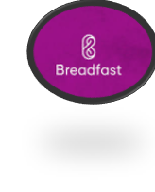
“Competitor 3: Breadfast”
Competition Area | Breadfast Strategy | GreenFork's Defense
Business Model | Subscription Q-Commerce: Sells fresh, reliable early-morning delivery of broad groceries and basic ready meals. | Match Reliability: GreenFork must match their logistical reliability but focus on the specialized nutritional science (not just freshness).
Core Focus | Logistics & Freshness: Owns the supply chain to guarantee consistency and timeliness, driving high subscription retention. | Pivot Narrative: GreenFork must pivot from general convenience/freshness to measurable health outcomes and dietitian-certified expertise.
Threat | Can easily add diet-friendly meals to its vast, existing logistics network, undercutting GreenFork on basic convenience. | Deepen Niche: Focus on highly personalized programs and specialized dietary needs (e.g., keto, specific allergies) to resist commoditization.

Slide 21
“Social Media Analysis”
 | Component | Detail (Focus on Egypt)
1 | Channel | Focus on Facebook for its broad demographic reach, especially the target audience (Social Class A, B).
2 | Link of channel | https://www.facebook.com/Breadfast
3 | Followers | 452K
4 | Reviews | Good
5 | Rating | 4.5
6 | About | "all daily essentials“ ,going "from bread to everything else".
7 | Posting Regular or not | Regular/Always-On
8 | # of posts/week | 4 - 7
9 | average likes / post | 100 - 300
10 | average Comments / post | 10 - 70
11 | Engagement Rate | 25%
12 | paid posts/not | Aggressive Advertising and Digital Marketing Dominance
13 | Type of content | Compelling content -relatable everyday scenarios
14 | Tone of voice | Creative, driven, and goal-oriented.
15 | Call-to-Action | Transactional ,Acquisition-focused
16 | Comments Replies | Yes
17 | Designs? | High-quality visual content
18 | Keep Identity | Yes
19 | Stories content | Yes
20 | Where in buyer journey | Awareness, Lead Generation, and Retention
21 | Language | English and Arabic.
 | Component | Detail (Focus on Egypt)
1 | Channel | Instagram
2 | Link of channel | https://www.instagram.com/breadfast/
3 | Followers | 264K
4 | Following | 1
5 | Reviews | Good
6 | Rating | 4.5
7 | About | Freshness, Convenience, and Community.
8 | Posting Regular or not | Regular
9 | # of posts/week | 5 - 7
10 | average likes / post | 50 - 100
11 | average Comments / post | 5 - 20
12 | Engagement Rate | Low
13 | paid posts/not | Influencer Partnerships
14 | Type of content | captivating storytelling
15 | Tone of voice | Innovation, Passion, and Purpose.
16 | Call-to-Action | Conversion-focused
17 | Comments Replies | Yes
18 | Designs? | Creative visual content
19 | Keep Identity | Yes
20 | Stories content | Yes
21 | Where in buyer journey | Content Marketing is used to build brand trust and authority. Data-Driven Personalization enhances loyalty.
22 | Language | Arabic and English

Slide 22
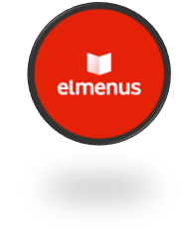
“Competitor 4: Elmenus”
Component | Summary (Healthy Focus) | Impact on GreenFork
Business Model | Uses visuals and filters to help users discover healthy restaurant options. | Impact: Sets the UX/UI benchmark;GreenFork must be cleaner and more personalized for health goals to beat general discovery.
Core Focus | Personalization & Dish Data (calories, macros); sells a curated experience. | Impact: Creates expectation of data-driven choice;GreenFork must use AI/data for personalized meal planning and health outcomes, not just simple browsing.
Threat | Strong discovery tools capture the user's decision-making process early. | Impact: Directly competes for the high-intent seeker;GreenFork must leverage certified expertise and a health education community to offer unmatched value.

Slide 23
“Social Media Analysis”
 | Component | Detail (Focus on Egypt)
1 | Channel | Instagram
2 | Link of channel | https://www.instagram.com/elmenus/
3 | Followers | 107K
4 | Following | 236
5 | Reviews | Good
6 | Rating | 4
7 | About | Focus on personalizing food recommendations at the dish-level through an AI-powered food recommendation engine.
8 | Posting Regular or not | Regular
9 | # of posts/week | 1 - 3
10 | average likes / post | 10 - 100
11 | average Comments / post | 2 - 5
12 | Engagement Rate | 6.6
13 | paid posts/not | Extensive paid media campaigns across Meta (Instagram) and TikTok/Snapchat to drive orders.
14 | Type of content | Curated food photos that visualize the next meal. Content is focused on answering the question: "What will I eat today?".
15 | Tone of voice | Creative and innovative.
16 | Call-to-Action | Focus on driving app install to first order.
17 | Comments Replies | Yes
18 | Designs? | Strong emphasis on social media graphics.
19 | Keep Identity | Yes
20 | Stories content | Yes
21 | Where in buyer journey | Discovery , Acquisition, and Retention.
22 | Language | Arabic
 | Component | Detail (Focus on Egypt)
1 | Channel | Facebook
2 | Link of channel | https://www.facebook.com/elmenus
3 | Followers | 601K
4 | Following | 13
5 | Reviews | Good
6 | Rating | 3.1
7 | About | Mission is to build the ultimate food platform.
8 | Posting Regular or not | Regular
9 | # of posts/week | 3 - 6
10 | average likes / post | 100 - 250
11 | average Comments / post | 2 - 40
12 | Engagement Rate | 6.6
13 | paid posts/not | Extensive paid media
14 | Type of content | High-quality graphics and visuals, Local Food Content
15 | Tone of voice | Collaborative and data-driven
16 | Call-to-Action | "Discover & Order Food". Also, offering discount.
17 | Comments Replies | Yes
18 | Designs? | Impactful creatives.
19 | Keep Identity | Yes
20 | Stories content | Yes
21 | Where in buyer journey | Discovery, Acquisition, and Retentio
22 | Language | Arabic , English

Slide 24
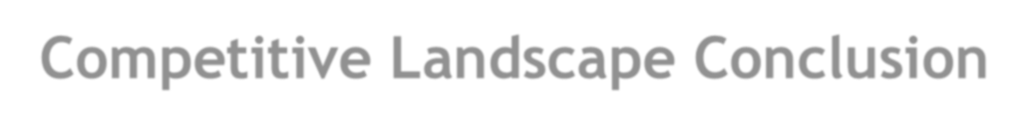
Competitive Landscape Conclusion
Talabat (The Scale Threat):
-Dominates the market through sheer size, massive funding, and heavy discounts.
#GreenFork's Defense: Must avoid competing on price and instead offer a premium, specialized, certified meal plan solution.
InstaShop (The Quick Commerce Rival):
-Excels at rapid delivery of groceries and household essentials, covering the raw ingredients market. #GreenFork's Defense: Must demonstrate that the value of the finished, specialized, prepared meal is superior to buying the ingredients and cooking yourself.
Breadfast (The Subscription Validator):
S-uccessfully built a large local logistics network based on a subscription/recurring order model. #GreenFork's Defense: Must match their logistics reliability but add the crucial element of expert, dietitian- approved meal plans as the core product.
elmenus (The UX Benchmark):
-Sets the standard for high-quality app design and personalized food discovery.
#GreenFork's Defense: Must surpass elmenus in the "health journey" experience, offering a cleaner app focused on nutrition tracking and personalized goals.

Slide 25
“Our - 6 Month SMART Objectives (The 5Ss)”
Pillar | Focus (Target) | Specific Goal (Activity) | KPIS | Timeline | Measurement Tools
1. Sell | 40% of total revenue from high-value subscription users. | Secure 300 new subscription sign-ups monthly. Achieve 100 first-time orders from new users monthly. | Revenue from Subs. Monthly Sign-ups. | 6 Months | GreenFork's internal CRM & Order Management System.
2. Serve | 90%+ Customer Satisfaction Score. 99% Order Accuracy. | Achieve 200 new app downloads (iOS & Android) monthly. | CSAT Score. Order Accuracy %. Monthly Downloads. | 6 Months | Google Analytics, Firebase, App Store Connect, Google Play Console.
3. Speak | 4% Social Media Engagement Rate Acquire 333 qualified leads/month. | Increase social media engagement to 4%. | Engagement Rate %. Qualified Leads/Month. | 6 Months | Instagram/Facebook Insights, third-party social media analytics tools.
4. Save | CAC for first-time user < EGP 50. ROAS target of 3:1. | Collaborate with 2-3 local fitness centers/nutrition clinics for B2B partnerships. | CAC. ROAS. No. of Partnerships. | 6 Months | CRM, Advertising Platforms, Internal sales tracking and contract reports.
5. Sizzle | 50%+ Net Promoter Score. | N/A (Focus is on measuring strong word-of-mouth growth). | NPS Score. | 6 Months | Internal customer surveys and tracking via CRM.

Slide 26
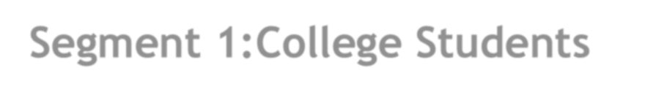

Segment 1:College Students
Demographics | Psychographics | Geographics | Behavioral
Age, Gender, Income, Education, Social Class | Interests, Personality, Lifestyle | Country, City, Location Type | Usage, Buying Decision, Benefit Sought
Age: 18-24 | Interests: Fitness, Socializing, Studying, Entertainment, Healthy eating (often due to trends). | Country: Egypt | Usage: Heavy usage of mobile apps (Talabat, Instashop) and social media (TikTok, Instagram).
Gender: Males & Females | Personality: Trend-aware, budget-conscious, seeking convenience, high energy, peer-influenced. | City: Cairo, Alexandria (Near major universities/campuses). | Decision Making: Quick decisions based on discounts, visual appeal, and peer recommendation.
Income: Low to Medium(dependent on parents/part-time jobs) | Lifestyle: Busy, often inconsistent schedule (lectures, late-night study, minimal cooking time). | Location Type: University campuses, dorms, shared apartments. | Benefit Sought: Affordability, Convenience/Speed, Healthy (guilt-free) options.
Education: University/College Level |  |  | Occasions: Study groups, exam periods, quick lunch breaks, social gatherings.
Social Class: B & C (due to low/medium disposable income)

Slide 27


Persona: College Students
Component | Detail
Title | Mona Ibrahim (The Budget-Conscious Scholar)
Location | Nasr City, Cairo (Lives near Ain Shams University)
Age | 21
Occupation | Full-Time Business Student / Part-Time Tutor
Goal | To eat healthier and maintain her energy levels during long study sessions without spending all her limited budget or sacrificing time.
Attitude | Optimistic but highly budget-sensitive. Skeptical of "fancy" diet fads, but trusts brands recommended by her favorite health/lifestyle influencers. Prioritizes speed and convenience.
Problem | 1. Affordability: Existing healthy options near campus are too expensive for daily purchase. 2. Convenience: Campus food is unhealthy, and she lacks time/kitchen space to cook and meal prep for herself. 3. Peer Pressure: Often ends up ordering fast food with friends because it's cheap and quick.
Solving by GreenFork | 1. Affordable Subscriptions: GreenFork's lower-cost subscription tier (499e.g student plan) fits her monthly budget better than daily single orders. 2. Healthy Speed: The promise of a quick, healthy, pre- portioned meal delivered directly to her apartment or campus lobby saves crucial study time. 3. Social Proof: Targeted promotions and partnerships with student organizations/influencers make ordering GreenFork a desirable, healthy group activity.

Slide 28
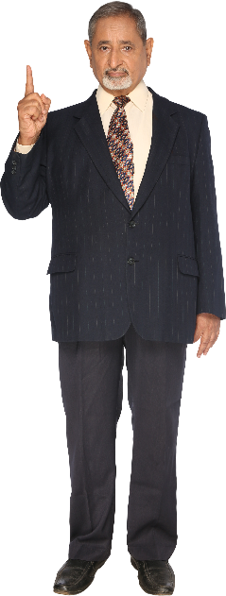
Segment 2: Employees
Demographics | Psychographics | Geographics | Behavioral
Age, Gender, Income, Occupation, Education | Interests, Personality, Lifestyle | Country, City, Location Type | Usage, Buying Decision, Benefit Sought
Age: 25-45 | Interests: Professional development, wellness, fitness, time efficiency, convenience. | Country: Egypt | Usage: High usage of online ordering/delivery during office hours (lunch/dinner).
Gender: Males & Females | Personality: Results-driven, time-poor, prioritize convenience over cooking, aspire to maintain a healthy image. | City: Cairo, Alexandria (Near central business districts / industrial parks). | Decision Making: Rational decision based on time saved, reliability, and quality/health perception.
Income: Medium to High | Lifestyle: Structured, busy, often sedentary, leading to a need for convenient healthy food options. | Location Type: Firms -Corporate offices, co-working spaces. | Benefit Sought: Convenience/Reliability (crucial for lunch breaks), Healthy Options (to avoid office fast food), B2B Benefits.
Occupation: Professionals, Managers, Engineers, HR Staff. |  |  | Occasions: Daily work lunch, team meetings, late working dinners.
Education: University Degree or Higher

Slide 29

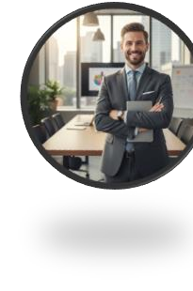

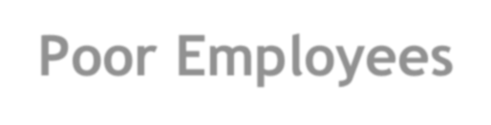
Persona 2: Time-Poor Employees
Component | Detail
Title | Waleed El-Sayed (The Time-Poor Professional)
Location | Maadi, Cairo (Works in the 5th Settlement business district)
Age | 38
Occupation | Senior Marketing Manager (Works 9 AM to 6 PM, often later)
Goal | To maintain his low-carb diet and high energy levels throughout his busy workday without relying on unhealthy fast food or wasting time commuting/cooking.
Attitude | Results-Oriented and Value-Conscious. Willing to pay a premium for solutions that reliably deliver on time and save him effort. Views GreenFork as an investment in his health and productivity.
Problem | 1. Time Scarcity: He has no time to prepare a specific diet meal in the morning or during his short lunch break. 2. Health Risk: Lunch options near the office are either unhealthy or inconsistent in quality. 3. Productivity: Poor diet choices during the week lead to low energy and afternoon crashes.
Solving by GreenFork | 1. Corporate Reliability: GreenFork's B2B/dedicated delivery ensures his meal arrives on time, every time, at his desk (crucial for short lunch breaks). 2. Customized Nutrition: The low-carb subscription plan eliminates the guesswork of diet adherence. 3. Seamless Convenience: His meals are pre-ordered, pre-paid, and delivered daily, saving him the mental load of ordering or planning his diet.

Slide 30
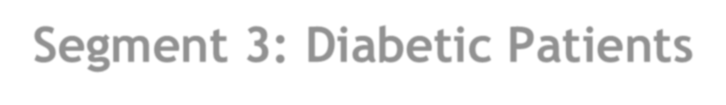
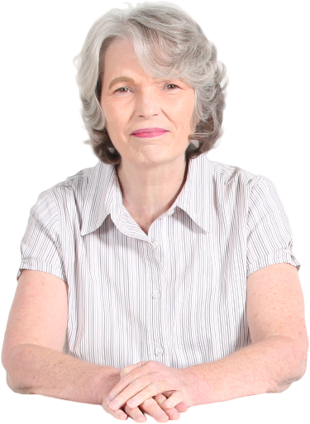
Segment 3: Diabetic Patients
Demographics | Psychographics | Geographics | Behavioral
Age, Gender, Income, Health Status | Interests, Personality, Attitude | Country, City, Location Type | Benefit Sought, Usage, Decision Making
Age: 35+ (Highest prevalence, but includes all ages) | Interests: Health management, medical advice, family well- being, longevity, reading food labels. | Country: Egypt | Benefit Sought: Precise macro- tracking (low sugar/carb), Reliability, Doctor-approved meals.
Gender: Both Males & Females | Personality: Risk-averse regarding food choices, seeking safety and high trust, highly disciplined (out of necessity). | City: Cairo, Alexandria (Due to better logistics/healthcare access). | Usage: High usage of health/telemedicine apps, likely to subscribe for long periods once trust is established.
Income: Medium to High | Attitude: Requires high level of trust, needs certification/proof (nutritionist approval) to use the service. | Location Type: Resides in areas with reliable delivery infrastructure. | Decision Making: Rational, medical-driven decision. Price is secondary to Trust and Health Outcomes.
Health Status: Diagnosed with Type 1 or Type 2 Diabetes, or pre-diabetic. |  |  | Occasions: Daily main meals, long-term diet planning.
Education: Varies but must be receptive to digital health tools.

Slide 31
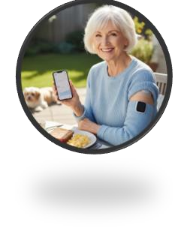
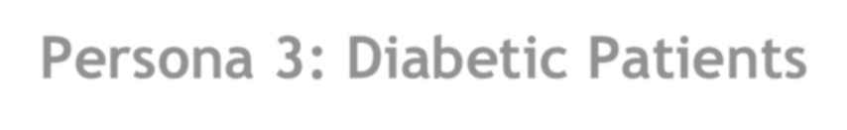
Persona 3: Diabetic Patients
Component | Detail
Title | Dr. Yara Fouad (The Health-Managed Senior)
Location | Zamalek, Cairo (High-end residential area)
Age | 62
Occupation | Retired University Professor
Goal | To strictly control her blood sugar levels and maintain her health regimen with minimal effort, ensuring every meal is medically safe and accurately portioned.
Attitude | Trust-Focused and Risk-Averse. Price is secondary to safety and reliability. She requires clear certification (nutritionist/doctor approval) and proof of quality.
Problem | 1. Medical Risk: Cannot rely on standard restaurant "healthy" options, which often contain hidden sugars or inaccurate carb counts. 2. Time/Effort: Cooking specialized diabetic-friendly meals daily is tiring and complex. 3. Inconsistency: Errors in meal prep at home or by a cheif can directly impact her health.
Solving by GreenFork | 1. Medical Compliance: GreenFork's certified, precise meal plan offers a safe, predictable substitute for cooking. 2. High Trust Features: The in-app feature showing precise nutritional labels and the option for consultation addresses her need for trust and safety. 3. Ultimate Convenience: The subscription eliminates the daily mental and physical load of meal prep, guaranteeing compliance without effort.

Slide 32
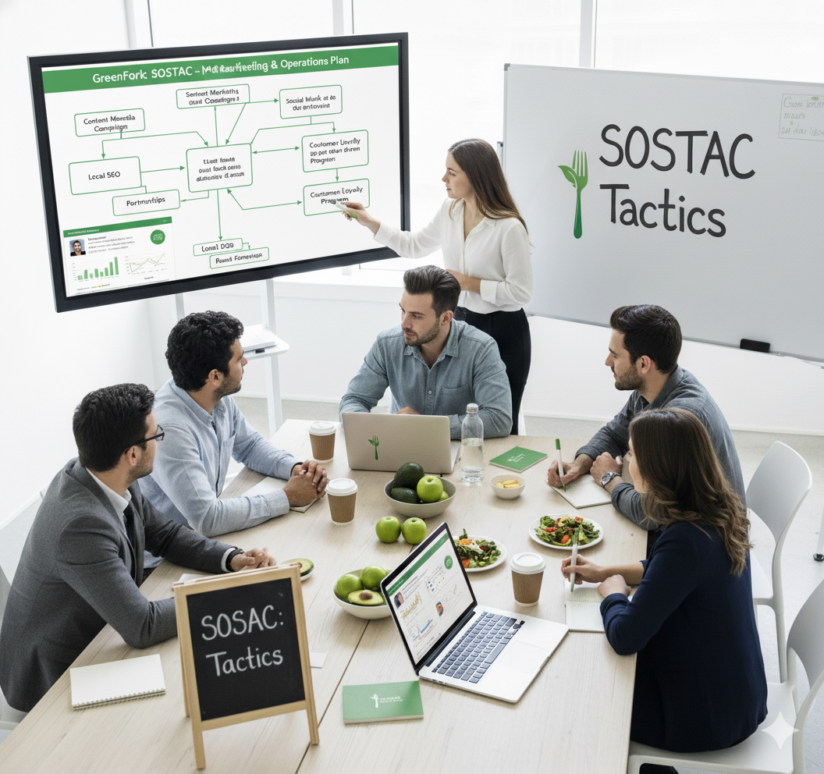

Slide 33
“1-Product & Service Tactics”
Tactic Area | Specific Action | Strategic Alignment
A. Core Offering | Formally introduce and market meal plans beyond general diet, focusing on the specialized certified diets like Keto, Calorie Control, and Sugar-Free. | Defense Against Scale (Talabat): Avoids competing on scale by offering highly specialized solutions.
B. Quality Control | Guaranteed Nutrition: Feature a "Nutritionist Approved" badge prominently on the app and marketing materials. Guarantee the accuracy of nutritional information (protein, carbs, calories) for every mea.. | Defense Against Ingredient Rival (InstaShop): Proves the value of the finished, specialized meal is superior to buying ingredients.
C. Technology & UX | Health Journey App: Enhance the app to surpass (Elmenus) UX by adding simple, personalized features for nutrition tracking and customization of meal plans for loyalty. | Defense Against Discovery (elmenus): Surpasses the general discovery experience by focusing on the user's health journey and goals.

Slide 34
“2-Price Tactics”
Tactic Area | Specific Action | Strategic Alignment
A. Subscription Tiers | Delineate Tiers: Clearly market two main subscription pathways: 1. Premium Personalized (targeting Employees/Diabetic Patients who prioritize reliability and customization 699 Plan)and 2. Value/Essentials (targeting Students with a lower-cost option, e.g., the EGP 499 plan ). | Drives profitability by maximizing CLV through the subscription model.
B. B2B Pricing | Corporate Packages: Develop specific B2B pricing models to secure the goal of 3-5 major corporate partners within 3 years. Emphasize the benefit of a dedicated, reliable lunchtime service to the time-poor professional segment. | Untapped Opportunity in Employee meal plans.
C. Promotions | Trial Conversion Offer: Use the 50 EGP QR code discount only at targeted offline events (health fairs, food weeks) to convert qualified leads into first-time orders. | Control (C) Metric: Track Conversion Rate of qualified leads (target: convert 20%).

Slide 35
“3-Place Tactics”
Tactic Area | Specific Action | Strategic Alignment
A. Delivery Reliability | Scheduled Delivery Guarantee: Implement and communicate a guaranteed, narrow delivery window (Pre-9 AM for breakfast, 12:30 PM for corporate lunch) to match the logistical reliability of Breadfast. | Defense Against Subscription Rival (Breadfast): Matches logistical consistency while adding specialized nutritional science.
B. Geographic Focus | -Concentrated Service Area: Initially focus delivery services only on the Greater Cairo Area. - Prioritize areas near major corporate offices (5th Settlement business district) and high-income suburbs (Maadi, Zamalek). | Maximizes logistical efficiency and AOV.
C. Channel Control | -App Exclusivity: Ensure all orders are placed via the GreenFork app. -Avoid listing on Talabat/Elmenus for subscription delivery to maintain full control over the customer relationship, data, and quality. | Focuses on driving app downloads (target: 200 new app downloads monthly).

Slide 36
“4-Promotion Tactics”
Tactic Area | Specific Action | Strategic Alignment
A. Authority Building | Influencer Partnerships: Secure short-term content creation contracts with Dr. Norhan Kandeel and Dr. Shrouk Ali. -The content focus should be on educating the audience about diabetes management and healthy eating, with GreenFork as the certified solution. | Core Strategy: Builds trust and credibility (SPEAK objective) before the sale.
B. Content & Social Media | -Engagement Focus: Dedicate content efforts to achieving a high engagement rate. -Share engaging content like meal photos, healthy tips, and customer testimonials. Generate a minimum of 60 qualified customer inquiries (Leads) via social media over 6 months. | Acquisition/Awareness Goal: Gain a minimum of 2,000 new, relevant followers.
C. Offline Presence | -High-Intent Lead Generation: Use health fairs (Egy Health Expo with Doctors/nutritionists) to directly target Diabetic Patients. -Use Cairo Food Week for visual appeal and tasting samples to attract the broader Employee segment. | Trial Marketing: Converts leads with low-risk testing.
D. Digital Ads | -Targeted Campaigns: Use paid Meta campaigns to target the psychographics of the corporate high-performer (time-poor, health-conscious, tech-savvy ) and use Google Ads to capture high-intent searchers for "diabetic meal delivery Cairo". | Drives online visibility and effective customer reach.

Slide 37
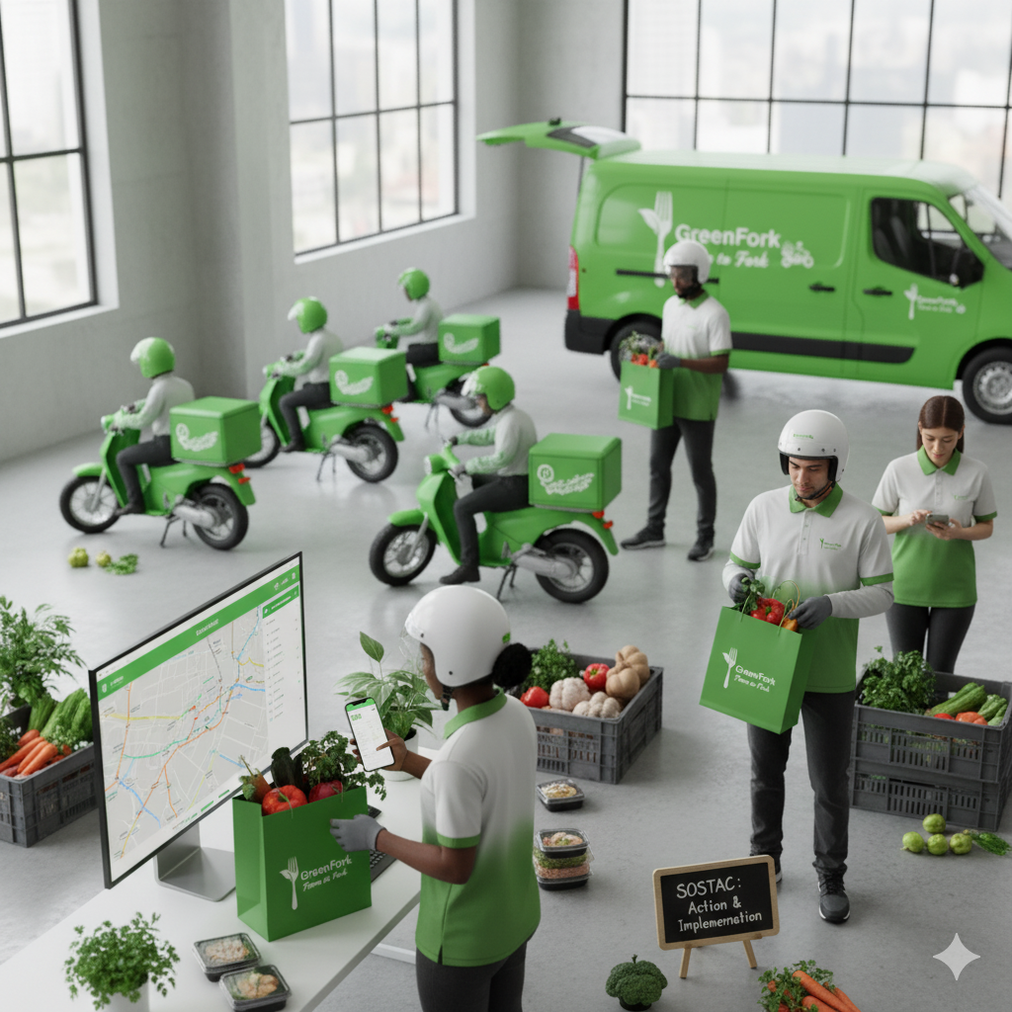

Slide 38
“Phase 1: Foundation & Authority (Days 1-90)”
Day Range | Core Goal | Tactic Focus | Key Actions | Responsibility
Days 1-30 | Product Awareness & Authority Launch | Product, Promotion (Influencers) | * Finalize product certification & nutritional labels. * Secure contracts with Dr. Kandeel & Dr. Ali. * Finalize app update scope (tracking/customization). | Product & Marketing
Days 31-60 | Lead Generation & Trial Prep | Promotion, Price (B2B/Offline) | * Launch Authority Content. * Develop B2B corporate pricing and sales pitch. * Secure booth space at Egy Health Expo or Cairo Food Week. | Marketing & Sales
Days 61-90 | Initial Conversion & Logistics Test | Price, Place (Trial & Reliability) | * Execute Offline Trial (Event participation & sample distribution). * Conduct 4-week Logistics Audit testing delivery guarantee. * Start B2B outreach to secure {3-5} corporate partners. | Sales & Operations

Slide 39
“Phase 2: Optimization & Conversion (Days 91-180)”
Day Range | Core Goal | Tactic Focus | Key Actions | Responsibility
Days 91-120 | Subscription Scale & App Improvement | Sell, Sizzle, Product (CLV & NPS) | * Launch first NPS survey. * Release and promote the enhanced app features (tracking/Calori Calc). *Optimize Ads to hit ROAS 3:1. | Marketing & Product
Days 121-150 | Partner Conversion & Retention | Save, Serve (B2B & CSAT) | Close 1-2 corporate B2B contracts. * Initiate referral partnerships with 2-3 fitness centers/clinics. * Maintain CSAT score 90% +. | Sales & Operations
Days 151-180 | Final Objective Review | All 5S Objectives | * Final subscription push to hit 300 new sign-ups/month (40%} revenue from subscriptions). * Perform final 99% order accuracy check. # Compile data for 6-Month Review and next strategy cycle. | All Teams & Management

Slide 40
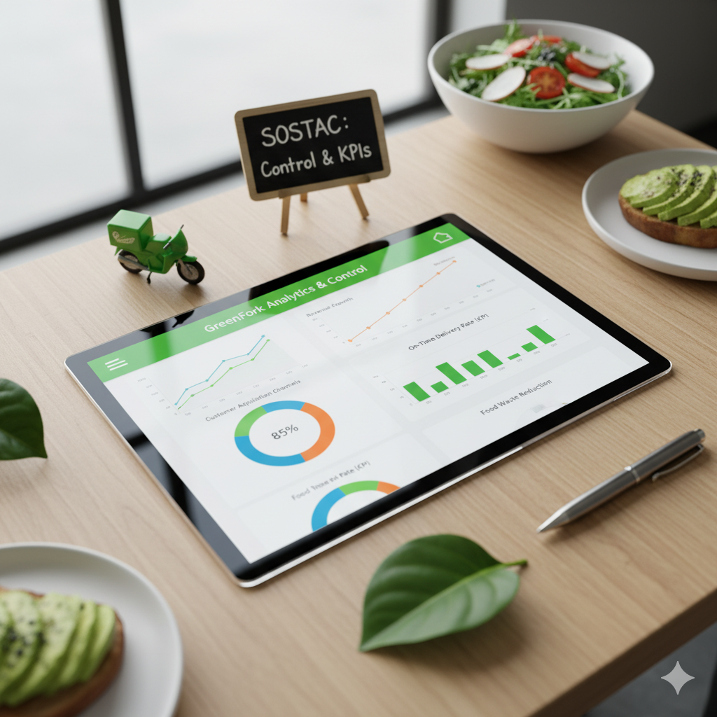

Slide 41
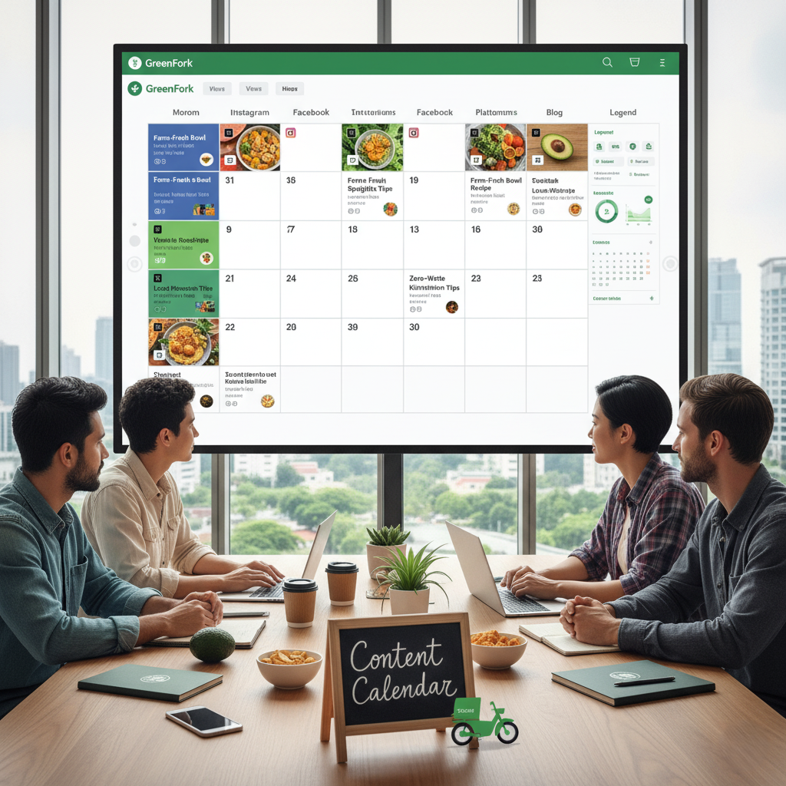

Slide 42
“Usage Of Time”
Platform | How Much | Target Time Slots
Facebook | 3-4 times per week (Feed) + 3 Stories/Week | 1:00 PM (Lunch Break), 7:00 PM – 9:00 PM (Evening Scroll)
Instagram | 5 Feed Posts/Week + Daily Stories + 2 Reels/Week | 11:00 AM – 1:00 PM (Lunch Scroll), 6:00 PM – 8:00 PM (Dinner Planning)
TikTok | 3-5 Posts/Week (Short-Form Video) | 12:00 PM – 3:00 PM (Lunch/Midday), 6:00 PM – 9:00 PM (Evening)

Slide 43
“Facebook Content Calender (1 Month)”
Week | Day | Segment Focus | Title | Caption
1 | Friday | (Diabetic Patients) | تحكم في سكرك بسهولة / Easy Blood Sugar Management | صحتك أهم! 💙 Greenfork بتقدم وجبات محسوبة الكربوهيدرات ونسبة السكر، مخصوص لمرضى السكري. Delicious food that keeps your glucose steady. شوف قائمة الـ Diabetic Meals! #وجبات_مرضى_السكري #DiabeticMealsEG
 | Monday | Product (Juice) | Morning Detox & Energy Boost | محتاج start قوي ليومك؟ 🔋 عصير الـ "Morning Booster" بتاعنا مليان antioxidants وفيتامينات طبيعية. The quickest way to get your vitamins! اشترك دلوقتي! #GreenforkJuice #عصائر_صحية
 | Thursday | (Employees) | وداعًا للـ Takeaway! / Stop the Office Takeout! | غداء صحي يوصل لحد مكتبك! 💼 وفر فلوسك ووقتك واختار وجبات Greenfork. هتكون energetic ومفيش إحساس بالخمول بعد الغداء. Delivery to all major business districts! #غداء_الموظفين #OfficeLunch
 | Sat | Engagement/Q&A | Which Meal is Your Goal? | ايه هدفك الصحي الفترة دي؟ 👇 نحافة، بناء عضل، ولا ثبات وزن؟ اختار خطة وجباتك من Greenfork! Let us handle the cooking! #HealthyGoals #FitnessEG
2 | Mon | (Fitness/Bodybuilders) | Protein Mix Muscle Fuel | وصل الـ Gains لحد عندك! 💪 البروتين ميكس بتاع Greenfork مصمم خصيصاً لدعم استشفاء العضلات. High-quality protein, zero fuss. اطلب ميكساتك الأسبوع ده! #بروتين_صحي #MuscleFuel
 | Wed | (College Students) | Smart Food, Smart Studying | أكل صحي للمذاكرة؟ أيوه! 🧠 وجبات Greenfork بتديك التركيز اللازم للامتحانات ومبتخليكش تحس بالـ "Crash" بتاع السكر. Order today and focus on your grades! #وجبات_الجامعة #StudentMeals
 | Fri | Behind the Scenes | Clean Kitchen, Healthy Food | شوف أكلنا بيتعمل إزاي! 🧑‍🍳 جولة سريعة في مطبخ Greenfork عشان تشوف بنفسك الـ standards العالية للنظافة والجودة في تحضير وجباتك. Quality you can trust. #مطبخ_جرينفورك #FoodSafetyEG
 | Sat | Engagement/Poll | Which Meal Type Are You Craving? | شرقي ولا غربي؟ 🤔 بتفضل تاكل فوتشيني مكرونة صحية، ولا وجبة محاشي لايت؟ Vote on your favorite healthy cuisine! #HealthyCuisine #أكل_صحي
3 | Mon | Day Post (Diabetic Tip) | Sweeteners and Glycemic Index | بدائل السكر: هل هي آمنة؟ 🍎 شرح مبسط لأحسن وأسوأ أنواع بدائل السكر اللي بنستخدمها في وجباتنا Diabetic. Learn why we choose specific natural sweeteners. #بدائل_السكر #LowSugar
 | Wed | Promotion/Offer | خصم خاص لأول اشتراك! / First-Time Subscriber Discount! | ابدأ حياة صحية بخصم! 🎉 اشترك في أي خطة أسبوعية أو شهرية واحصل على خصم 25% على أول طلب! Limited time for new clients! #عروض_صحية #SubscriptionOffer
 | Fri | Normal Clients/Maintenance | Stay Healthy, Effortlessly | مش محتاج تعمل دايت عشان تاكل صحي! ✨ Greenfork بتقدم وجبات Balanced مثالية لأي شخص عايز يحافظ على صحته ووزنه من غير حرمان. Simple, balanced, and delicious. #حياة_صحية #HealthyMaintenance
 | Sat | Students/Employees | Delivery Map Showcase | أين تذهب وجباتنا؟ 🗺️ هل بنوصل لمنطقتك؟ صور لخريطة التوصيل بتاعتنا! Check our wide coverage across Cairo/Giza/etc. اكتب اسم منطقتك وهنرد عليك! #توصيل_وجبات #DeliveryEG

Slide 44
“Instagram Content Calender (1 Month)”
Week | Day | Segment Focus | Title | Caption | Hashtags
1 | Friday | (Diabetic Patients) | تحكم في سكرك بسهولة / Easy Blood Sugar Management | صحتك أهم! 💙 Diabetic meals are stress-free now. وجبات محسوبة الكربوهيدرات بدقة عشان متقلقش. | #وجبات_مرضى_السكري #DiabeticMealsEG #سكر_الدم #تغذية_صحية
 | Monday | Product (Juice) | Morning Detox & Energy Boost | Fuel your day in 5 seconds! ⚡️ عصير "Morning Booster" هو أسرع وألذ طريقة تاخد بيها فيتاميناتك. Forget the coffee crash! | #GreenforkJuice #عصائر_صحية #DetoxEG #EnergyBooster
 | Thursday | (Employees) | وداعًا للـ Takeaway! / Stop the Office Takeout! | غداء صحي يوصل لحد مكتبك! 💼 وجبات متوازنة عشان تخليك focused ومفيش خمول بعد الغداء. Delivery to all business districts! | #غداء_الموظفين #OfficeLunch #WorkFromCairo #GreenforkDelivery
 | Sat | Engagement/Q&A | Which Meal is Your Goal? | ايه هدفك الصحي الفترة دي؟ 🎯 شاركنا رقمك! (1. تخس، 2. تبني عضل، 3. ثبات وزن). Let us handle the cooking! | #HealthyGoals #FitnessEG #NutritionPlan #GoalSetting
2 | Mon | Fitness/Bodybuilders | Protein Mix Muscle Fuel | وصل الـ Gains لحد عندك! 💪 High-quality protein, zero fuss. ميكسات بروتين طبيعية لدعم استشفاء العضلات. Skip the powder! | #بروتين_صحي #MuscleFuel #GymLifeEG #كمال_اجسام
 | Wed | (College Students) | Smart Food, Smart Studying | أكل صحي للمذاكرة؟ أيوه! 🧠 وقود نضيف عشان تركز في الامتحانات. وجبات بتديك الطاقة والتركيز ومفيش Sugar Crash. | #وجبات_الجامعة #StudentMeals #CampusLife #مذاكرة
 | Fri | Behind the Scenes | Clean Kitchen, Healthy Food | صحتك عندنا رقم واحد! 🥇 Take a peek inside! جولة في مطبخنا لنرى الـ world-class standards في النظافة والجودة. | #مطبخ_جرينفورك #FoodSafetyEG #CleanKitchen #BehindTheScenes
 | Sat | Engagement/Poll | Which Meal Type Are You Craving? | شرقي ولا غربي؟ 🤔 Greenfork عندها النسخة الصحية لكل وجبة. The best of both worlds, guilt-free! صوتوا! | #HealthyCuisine #أكل_صحي #FoodPoll #DietTips
3 | Mon | Diabetic Tip | Sweeteners and Glycemic Index | بدائل السكر: هل هي آمنة؟ 🧐 شرح مبسط لأفضل المحليات الطبيعية اللي بنستخدمها في وجباتنا. We do the research so you don't worry! | #بدائل_السكر #LowSugar #DiabeticTips #GlycemicIndex
 | Wed | Promotion/Offer | خصم خاص لأول اشتراك! / First-Time Subscriber Discount! | 🔥 25% OFF YOUR FIRST ORDER! 🔥 اشترك في أي خطة واحصل على خصم 25%. Limited time for new clients! استخدم كود: FIRST25. | #عروض_صحية #SubscriptionOffer #خصومات #HealthyDeals
 | Fri | Normal Clients/Maintenance | Stay Healthy, Effortlessly | Just stay healthy, no diet needed! ✨ وجبات Greenfork Balanced للحفاظ على جسم صحي ووزن مثالي من غير حرمان. Simple, balanced, and delicious. | #حياة_صحية #HealthyMaintenance #BalancedMeals #EatClean
 | Sat | Delivery Map | Delivery Map Showcase | بنغطي منطقتك؟ 🗺️ Delivery all across Cairo & Giza! اكتب اسم منطقتك وهنرد عليك بتفاصيل التوصيل! We bring the health to you. | #توصيل_وجبات #DeliveryEG #ServiceArea #CairoDelivery

Slide 45
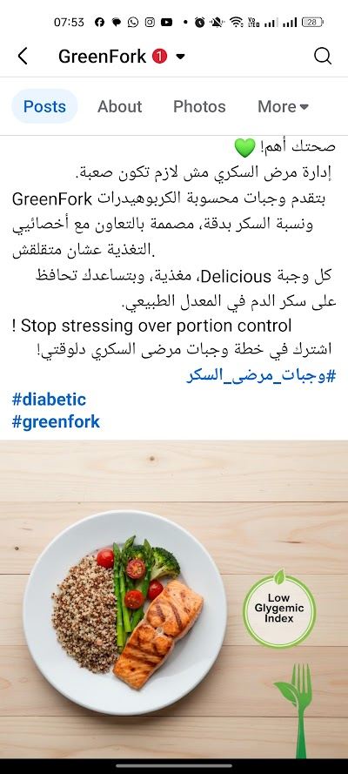
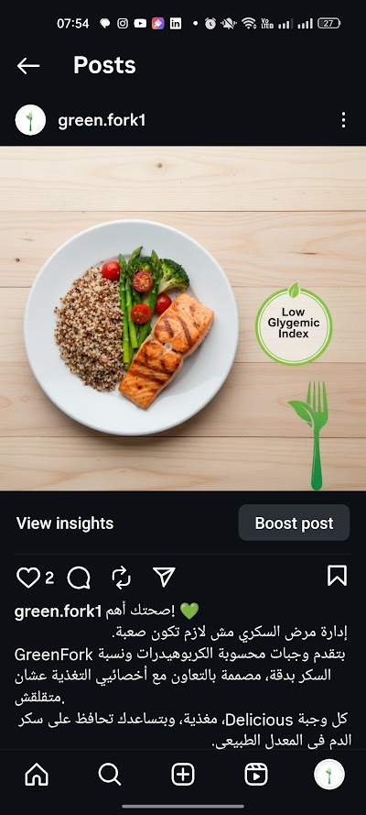
“Posts”

Slide 46
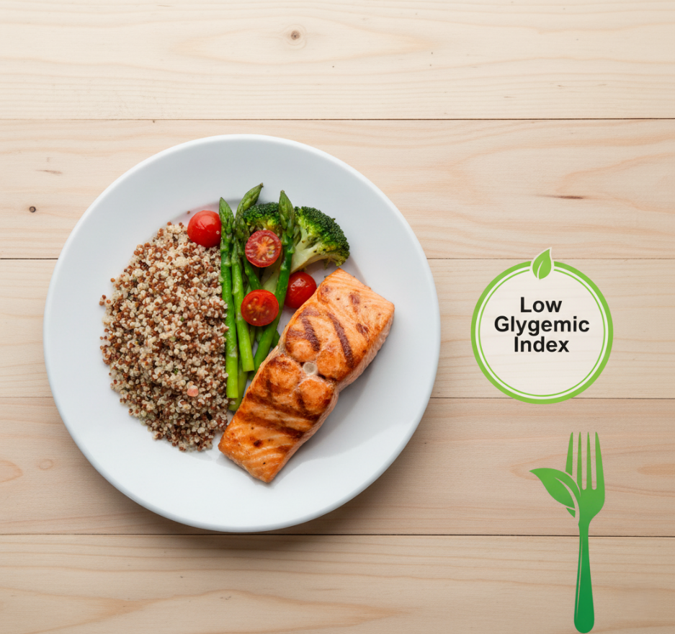
“Diabetic Patients Segment Post Visuals”
FB Caption:
صحتك أهم!
إدارة مرض السكري مش لازم تكون صعبة.
GreenFork بتقدم وجبات محسوبة الكربوهيدرات ونسبة السكر بدقة، مصممة بالتعاون مع أخصائيي التغذية عشان متقلقش.
كل وجبة Delicious، مغذية، وبتساعدك تحافظ على سكر الدم في المعدل الطبيعي.
! Stop stressing over portion control
اشترك في خطة وجبات مرضى السكري دلوقتي!
#وجبات_مرضى_السكر
#diabetic
#greenfork
Instagram Caption:
صحتك أهم! 💙 Diabetic meals are stress-free now. وجبات محسوبة الكربوهيدرات بدقة عشان متقلقش. #diabetic #وجبات_مرضى_السكر
#GreenFork

Slide 47
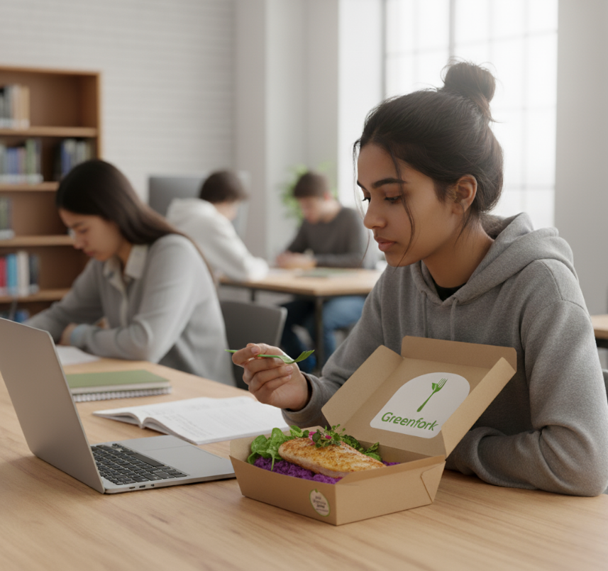
“College Students Segment Post Visuals”
Facebook Caption:
Instagram Caption:
أكل صحي للمذاكرة؟ أيوه! 🧠 وقود نضيف عشان تركز في الامتحانات. وجبات بتديك الطاقة والتركيز ومفيش Sugar Crash. Order today and focus on your grades! #وجبات_الجامعة #StudentMeals
أكل صحي للمذاكرة؟ أيوه! 🧠 وقود نضيف عشان تركز في الامتحانات. وجبات بتديك الطاقة والتركيز ومفيش Sugar Crash. #وجبات_الجامعة #StudentMeals #مذاكرة

Slide 48
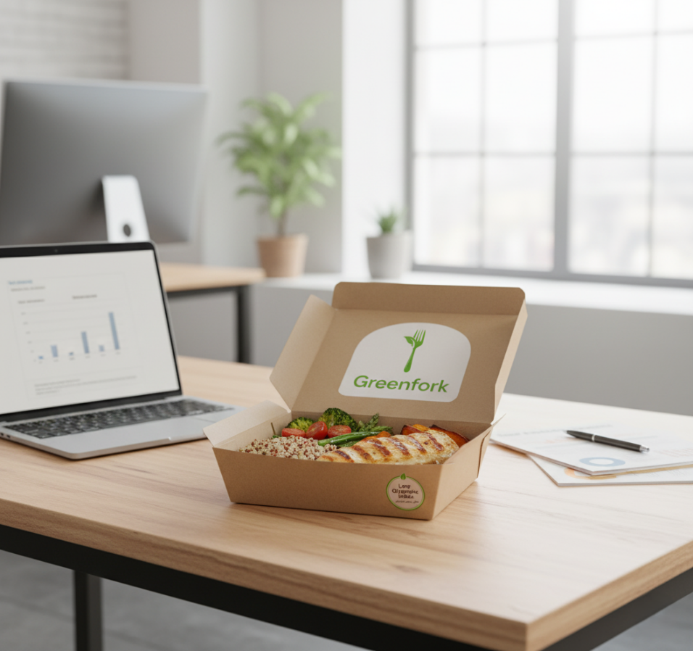
“Employee Segment Post Visuals”
FB Caption:
Instagram Caption:
غداء صحي يوصل لحد مكتبك! 💼 لو أنت موظف وبتزهق من الأكل السريع أو الأكل اللي بيسبب خمول بعد الظهر، Greenfork هو الحل. وجباتنا متوازنة ومصممة عشان تخليك مركزطول اليوم. No more afternoon slump! Delivery to all major business districts in Cairo and Giza! ابدأ اشتراكك اليوم. #غداء_الموظفين #OfficeLunch #GreenFrok
غداء صحي يوصل لحد مكتبك! 💼 لو أنت موظف وبتزهق من الأكل السريع أو الأكل اللي بيسبب خمول بعد الظهر، Greenfork هو الحل. وجباتنا متوازنة ومصممة عشان تخليك مركزطول اليوم. No more afternoon slump! Delivery to all major business districts in Cairo and Giza! ابدأ اشتراكك اليوم. #غداء_الموظفين #OfficeLunch #GreenFrok

Slide 49
“Daily Content Management”
Daily Engagement : Spend 15 minutes every evening to respond to all comments and direct messages. - Messenger Chat Bot
Influencer Tracking: Use the tracking dashboard to monitor the Engagement Rate % on influencer content, If the rate is low, quickly pivot the content theme.
Ad Spend: Allocate paid budget to boost the best performing Authority Content (Week 1-4) and the Conversion CTAs (Week 9-12) to ensure the 333 leads/month target is met.

